Slide 1
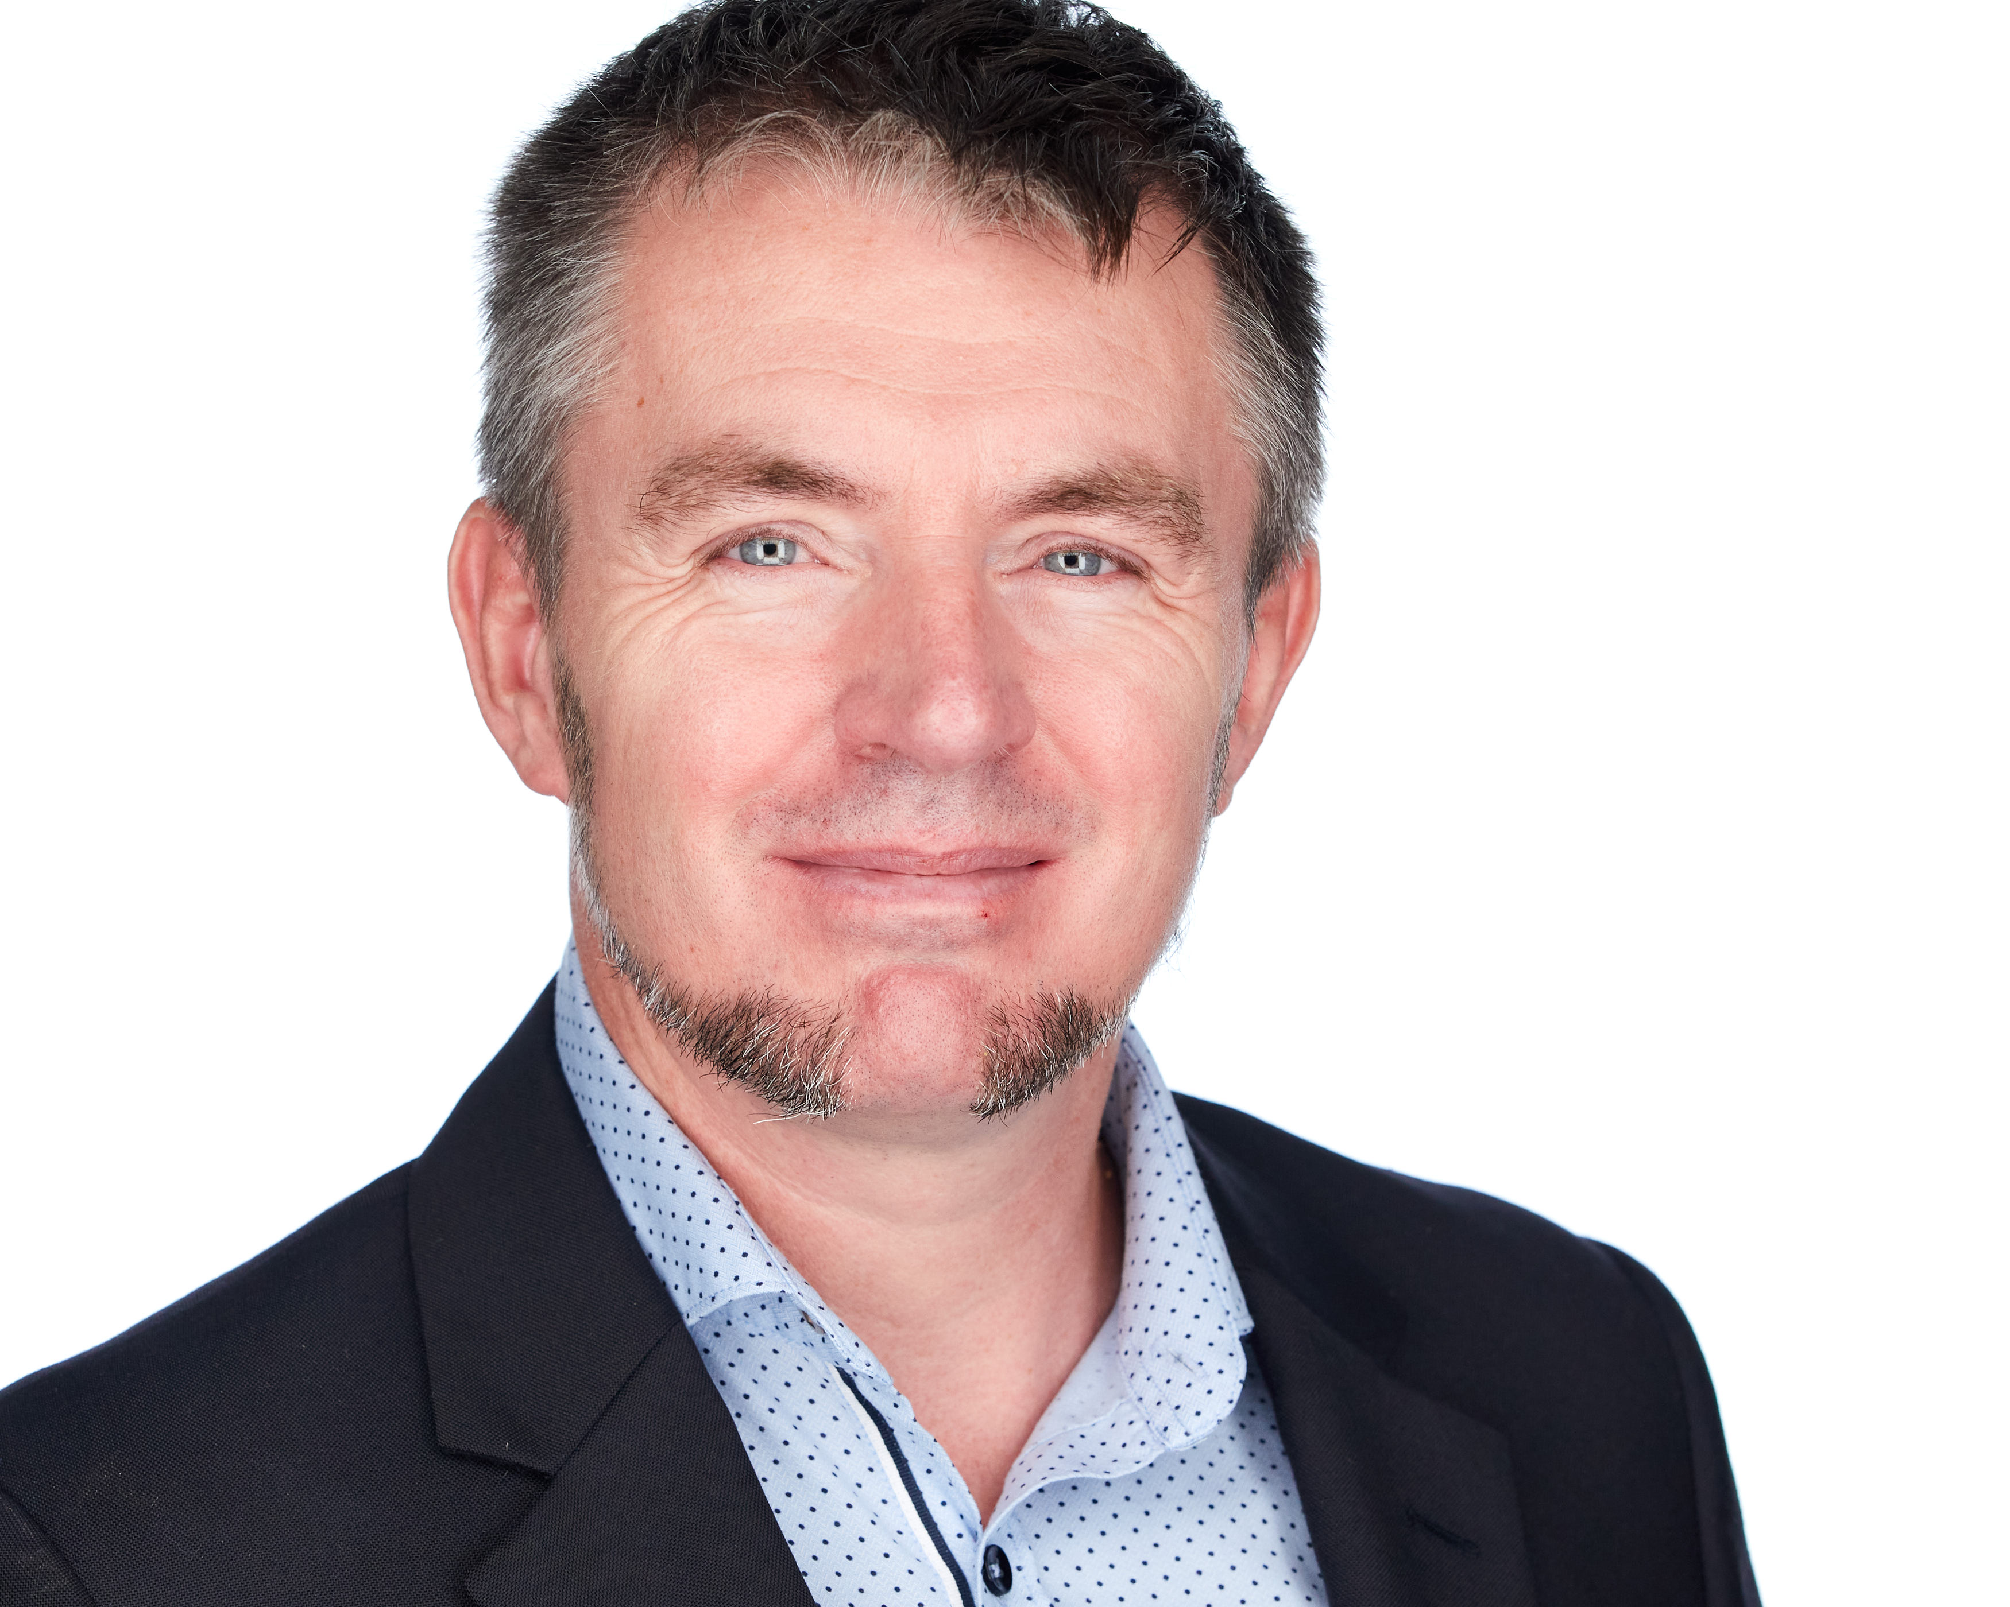





JON-PAUL BOYD
Intelligent Systems Engineer
A multi-skilled SAP HANA technical architect & A.I. engineering postgrad who thrives on delivering tangible, cutting-edge solutions that inform, empower & perform. I help clients solve business challenges fast with strong theory, practical hands-on, clarity of thought and communication.
+41 (0)79 952 18 81 jp@corticalstack.ai corticalstack.ai jonpaulboyd Nyon, CH
CAREER HIGHLIGHTS
EDUCATION
STATS
SAP HANA Technical Architect
Nestle | Vevey, CH | 2014 – 2017
Technical lead, inspiring team implementing groundbreaking first HANA-based analytic reporting solution for 3000 users.
Led 5 HANA major upgrades & migration of analytics sidecar to embedded NetWeaver/HANA dual stack.
Extensive XSC/XSA development with database modelling, Fiori, SQLScript, XSJS, Node.js, security, optimisation.
Developed automated tool for analytic privileges build & assign, performance tool measuring query runtimes vs KPIs.
Configured HANA workload management, HALM, HRF. Major contributor to Nestle HANA Development best practices.
Daily liaison with Nestle & SAP partners, presentation to management, key users, technical and product teams.
Learned I’m still hungry for technical challenges.
SAP HANA Technical Architect
Bluefin Solutions | London, UK | 2014
Helped BAT realise Gartner’s Logical Data Warehouse concept by implementing HANA SDA for data federation of London & Sydney databases.
Developed P&L with sub-second performance (legacy 2m10s), SAP Fiori KPI dashboard with line item drill-down.
Learned trust won on transparency & keeping delivery promises goes a long way.
SAP HANA Technical Architect
HANA Propulsion Laboratory| Blonay, CH | 2013
Engineered remote piloted vehicle with real time telemetry to Cloud-hosted HANA database for analytics & real time vehicle control via openUI5 browser cockpit.
Data mining for game analytics &achievement/reward system tied to mission objectives & pilot behaviour.
Learned benefits of deep and wide research.
SAP Web Dynpro ABAP Consultant
Nestle| Vevey, CH | 2010 – 2013
Lead developer for complex development & problem-solving, delivered technical training for offshore teams.
Brought sophisticated recipe change doc concept to life with UI design driven by simplicity, familiarity & customisation.
Learned greater self-belief & improved interpersonal skills through learning from others.
SAP ABAP Consultant
Belgian Railways| Brussels, BB | 2008 – 2010
With a natural team-lead expertise successfully delivered a warehouse management shipment handling project.
Individually responsible for complex bespoke development functionality within logistics execution.
Learned love of OO dev & software in physical systems.
SAP ABAP Consultant
Cap Gemini| Middlesbrough, UK | 2000 – 2008
Senior ABAP dev in SAP competency centre, responsible for on-going support, dev & upgrades for several clients.
Analysed customer SAP systems from ABAP perspective to enable the smooth transitioning to SAPrun support.
Delivered revenue earning on-site consultancy/training.
Work pipeline management and assignment, training and support of 3 ABAP developer colleagues.
Innovated systems integration monitoring dashboard.
Learned rewards of coaching juniors.
Masters Intelligent Systems
De Montfort University | UK | 2017 – 2020
Discovered why stronger partnerships should exist between enterprise and academia.
Applied Computational Intelligence (88%) Predicting customer behaviour with tree-based classifiers. Extensive Python with data profiling & preparation, unsupervised & supervised machine learning, overfitting protection, hyperparameter tuning, model scoring, evaluation & selection.
A.I. Programming (80%)
NLP with Python & NLTK context-free grammars for natural language to formal SQL database query.
Data Mining (80%)
Full-flow data mining analysis and machine learning to predict risk indicators for cardiovascular disease.
Neural Networks (80%)
Evaluation of biomass & classification of network activity (intrusion, attack or normal) with nn’s.
Fuzzy Logic (94%)
Classification of breast cancer tumours with fuzzy inference system (outperforming neural networks & other ML approaches). Paper being submitted to journal of Applied Soft Computing for publication.
Research Methods (96%)
PhD proposal for augmented analytics.
Mobile Robots (97%)
Virtual search & rescue robot controlled via Python API, implementing obstacle avoidance, sensor data fusion, environment mapping, precision navigation and victim location.
Computational Intelligence Optimization (100%) Design and build of Hyper-heuristic Optimization Platform, a Python-based framework to address the real-world problem of scheduling optimisation. 5 example nature-inspired metaheuristic algorithms are implemented. A hyper-heuristic feature dynamically switches between low-level metaheuristics to deterministically use the most appropriate algorithm according to current problem state, or select one stochastically.
Masters Project In Progress
Building cloud-hosted medical research cockpit for knowledge discovery, summarization, topic classification and clustering etc for best-informed next stage research actions, using COVID-19 literature as unstructured data sources.
24
Years software dev
13
Years SAP ABAP dev
5
Years HANA dev
8
Masters modules graded distinction
36
Companies provided expertise
12
Times consulting contract extended
1
Individual delivering client centric excellence
TOOLS
Python
Pandas
Numpy
Scikit-Learn
Keras
NLTK
Elasticsearch MongoDB
SAP HANA
SAP Fiori
SAP ABAP
SAP Security
ReactJS
JavaScript
Amazon AWS
MS Azure
Docker
Git
GitLab
Jira
Linux
Windows 10
SAS
PRAISE
“Tech savvy, experienced, meticulous, committed, dependable, ingenious and eager to learn more”
Rudi Dutli, Principal, Infosys Lodestone
“Builds comprehensive & passionate understanding of the architectures & frameworks involved, educating and inspiring teams and co-workers in the process. A real flair for challenging, on-the-edge development”
Trond Stroemme, Team Lead, SAP App Tech Expertise Centre, Nestle
“An expert in his domain and a great team player. His focus on results with optimal quality is outstanding”
Norbert Rignall, Master Data Solution Architect, Nestle

